Slide 1
Design a Web Agency App
Muneeb ur Rehman

Slide 2
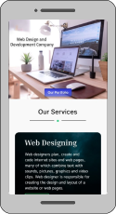
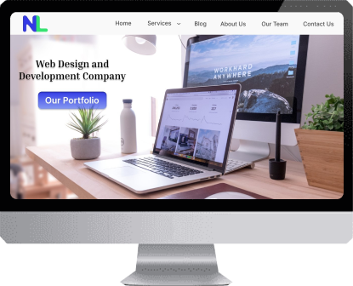
Project overview
The product:
It is a Web Agency Service App for those people who want to expand their work or brand worldwide. This app is easy to use, and I design this app only for the social welfare of my society.
Project duration:
September to October 2022.

Slide 3
Project overview
The problem:
People have difficulties expanding their brand worldwide, but they haven’t any platform where they can show their material or business inventory.
The goal:
Our goal is to provide a web agency service app to those who want to expand their brand worldwide.

Slide 4
Project overview
My role:
UI/UX designer designing a Web agency service app for those who want to expand their work or brand worldwide from conception to delivery.
Responsibilities:
Conducting interviews, paper and digital wireframing, low and high-fidelity prototyping, conducting usability studies, accounting for accessibility, and iterating on designs.

Slide 5
User research
Personas
Problem statements
User journey maps
Understanding
the user

Slide 6
User research: summary
I conducted interviews and created empathy maps to understand the users I was designing for and their needs. A primary user group identified through research that they had difficulty expanding their work or brand worldwide because they want to get more customers.

Slide 7
User research: pain points
1
2
3
Exposure
Familiarity
Feedback
Brands have difficulty accessing more clients worldwide.
A lot of people or clients haven’t familiar with the particular brand.
Brands need feedback on their product from customers.

Slide 8
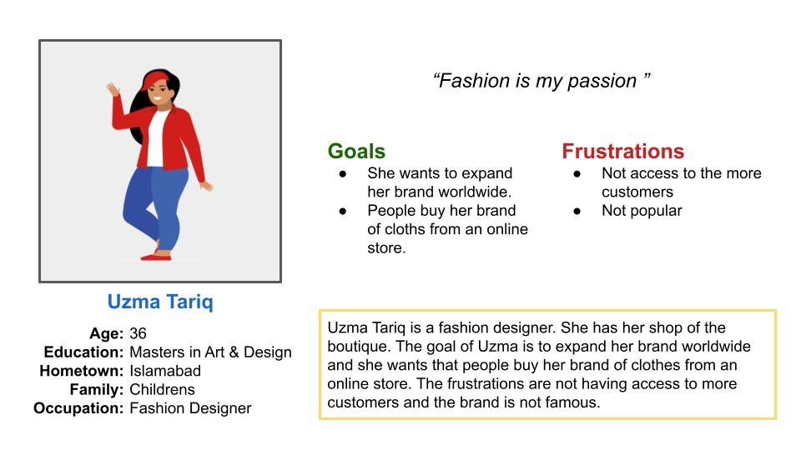
Persona: Uzma Tariq
Problem statement:
Uzma Tariq is a Fashion designer who needs to expand her brand worldwide because she wants to get more customers.

Slide 9
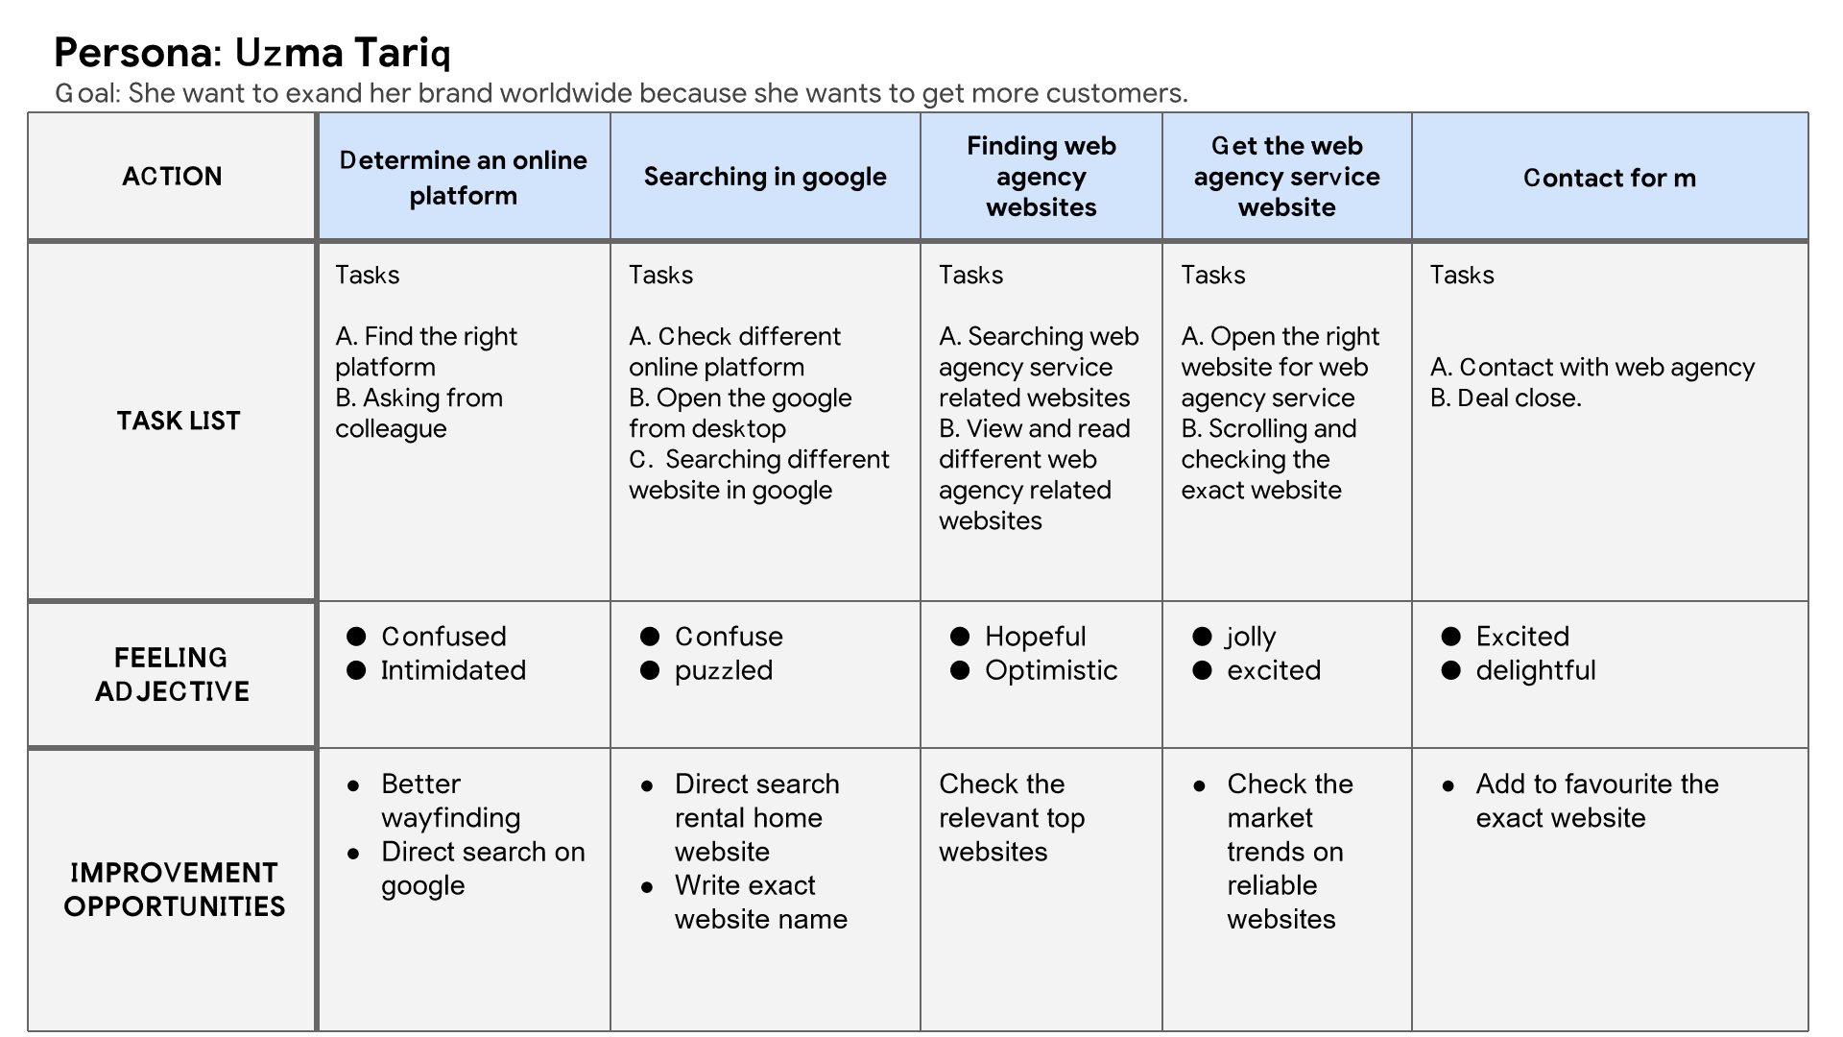
User journey map
Mapping Uzma tariq user journey revealed how helpful it would be for users to have access to a dedicated Web agency service app.

Slide 10
Paper wireframes
Digital wireframes
Low-fidelity prototype
Usability studies
Starting
the design

Slide 11
Paper wireframes
Taking the time to draft iterations of each screen of the app on paper ensured that the elements that made it to digital wireframes would be well-suited to address user pain points. For the home screen, I prioritized all relevant services that users can avail of and contacted the web agency.

Slide 12
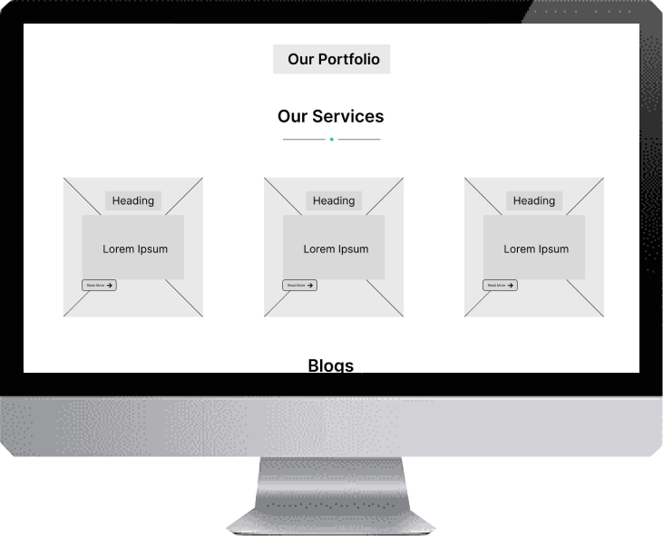
Digital wireframes
This button shows the portfolio of the company which shows the creativity of web agency.
As the initial design phase continued, I made sure to base screen designs on feedback and findings from the user research.
This button shows the main services of the web agency.

Slide 13
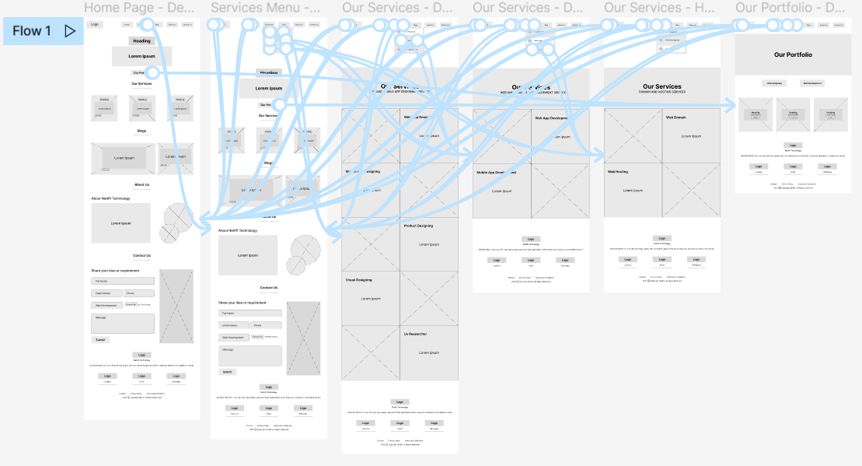
Low-fidelity prototype
Using the completed set of digital wireframes, I created a low-fidelity prototype. The primary user flow I connected was complete detail of all services related to website, So the prototype could be used in a usability study.
View Web Agency Service App
Low Fidelity Prototype

Slide 14
Usability study: findings
I conducted two rounds of usability studies. Findings from the first study helped guide the designs from wireframes to mockups. The second study used a high-fidelity prototype and revealed what aspects of the mockups needed refining
Round 1 findings
Round 2 findings
1
User needs services are displayed on the main screen or landing page.
1
The user needs a portfolio button on the main screen or landing page.
Users need a more convenient way to contact a web agency.
2
Users need more details about the website design.
2

Slide 15
Refining
the design
Mockups
High-fidelity prototype
Accessibility

Slide 16
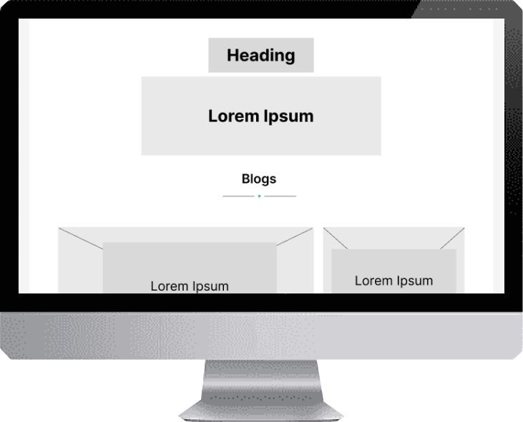
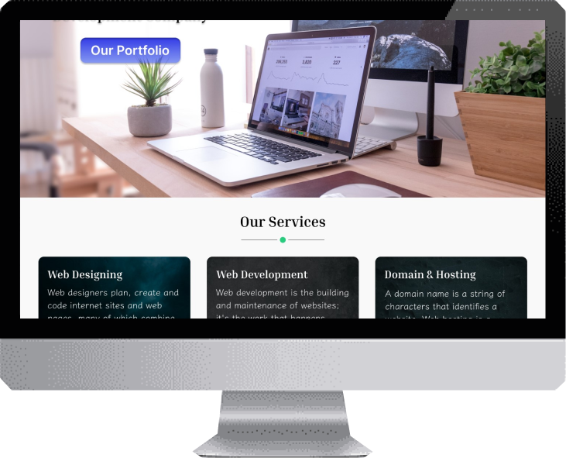
Mockups
Before usability study
After usability study
Based on the insight from the usability studies, I applied design changes like providing main services on the homescreen or landing page.

Slide 17
Mockups
Before usability study
After usability study
Additional design changes included adding a button for our portfolio, Now the users can easily view the company projects or designs.

Slide 18
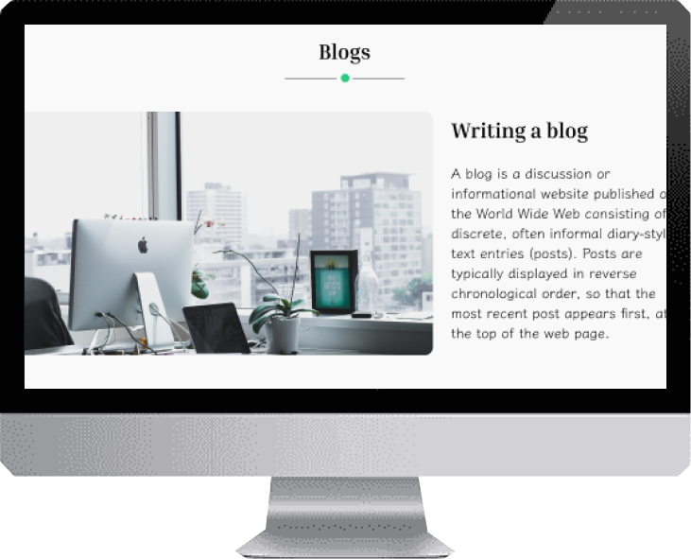
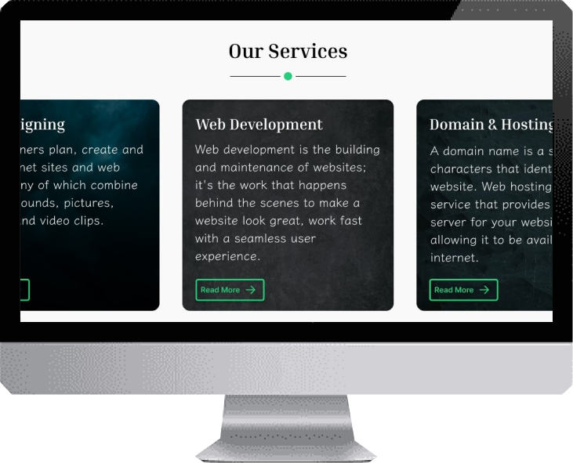
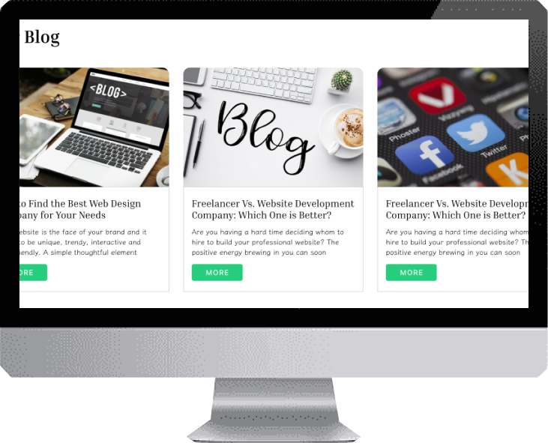
Mockups

Slide 19
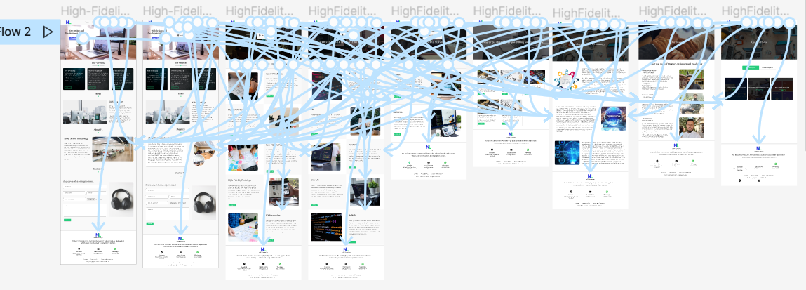
High-fidelity prototype
The final high-fidelity prototype presented cleaner user flows for website services. It also met the user's need to add our portfolio button to see the company profile or designs.
View Home Rental App
High Fidelity Prototype

Slide 20
Accessibility considerations
1
2
3
Provided access
to users who are vision impaired through adding alt text to images for screen readers.
Used icons to
help make
navigation easier
Used clear indications for every step to use or find specific property type

Slide 21
Responsive Design
Information Architecture
Responsive Design

Slide 22
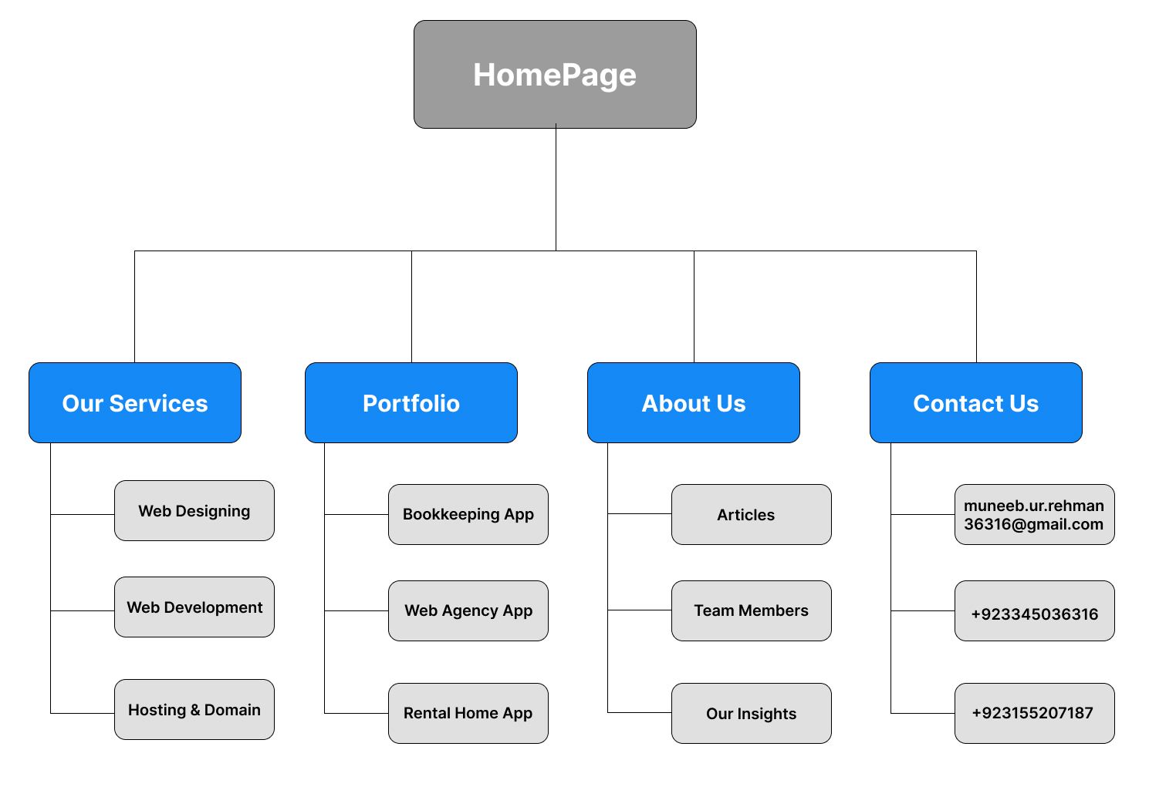
Sitemap
With the app designs completed, I started work on designing the responsive website. I used the web agency service sitemap to guide the organizational structure of each screen’s design to ensure a cohesive and consistent experience across device.

Slide 23
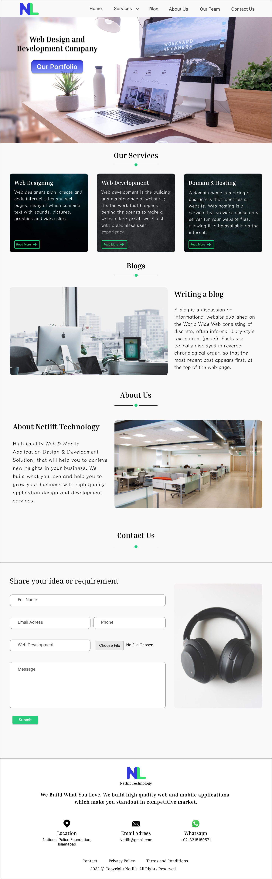
Responsive Design
Mobile Website
Desktop
The designs for screen size variation included mobile, tablet and desktop. I optimized the designs to fit specific user needs of each device and screen size.

Slide 24
Going forward
Takeaways
Next steps

Slide 25
Takeaways
Impact:
The app makes users feel like a Web agency service app thinks about how to meet their needs.
One quote from peer feedback:
“The app made it so easy and useful to complete the services of the website. I would use this app to expand my brand worldwide”.
What I learned:
While designing the Web agency service app, I learned that the first ideas for the app are only the beginning of the process. Usability studies and peer feedback influenced each iteration of the app’s designs.

Slide 26
Next steps
1
2
Conduct another round of usability studies to validate whether the pain points users experienced have been effectively addressed.
Conduct more user research to determine any new areas of need.

Slide 27
Insert a few sentences summarizing the next steps you would take with this project and why. Feel free to organize next steps in a bullet point list.
Let’s connect!
Thank you for your time reviewing my work on the Web agency service app! If you’d like to
see more or get in touch, my contact information is provided below.
Email: muneeb.ur.rehman36316@gmail.com
Contact: +92 334-5036316

Slide 28
Thank you!

